Slide 1


WELDING ROBOT MANIPULATOR
Presenting by
B Sai Abhishek BL.EN.U4AIE21015
B Ruchith Balaji BL.EN.U4AIE21017
Chillakuru Hari BL.EN.U4AIE21038
21AIE201- Introduction to Robotics

Slide 2
Contents:
Main Objective.
Introduction.
Implementation
Code
Result Video
Conclusion

Slide 3
Main Objective:
To Design and implement a welding robot with a suitable degree of freedom.
To make the robot that it should be able to weld the given location and area.

Slide 4
Introduction:
Problem Statement
Creating a Welding Manipulator.
involves designing and implementing.
must have the suitable DOF to accurately.
weld the desired location.
Challenges….Control System

Slide 5
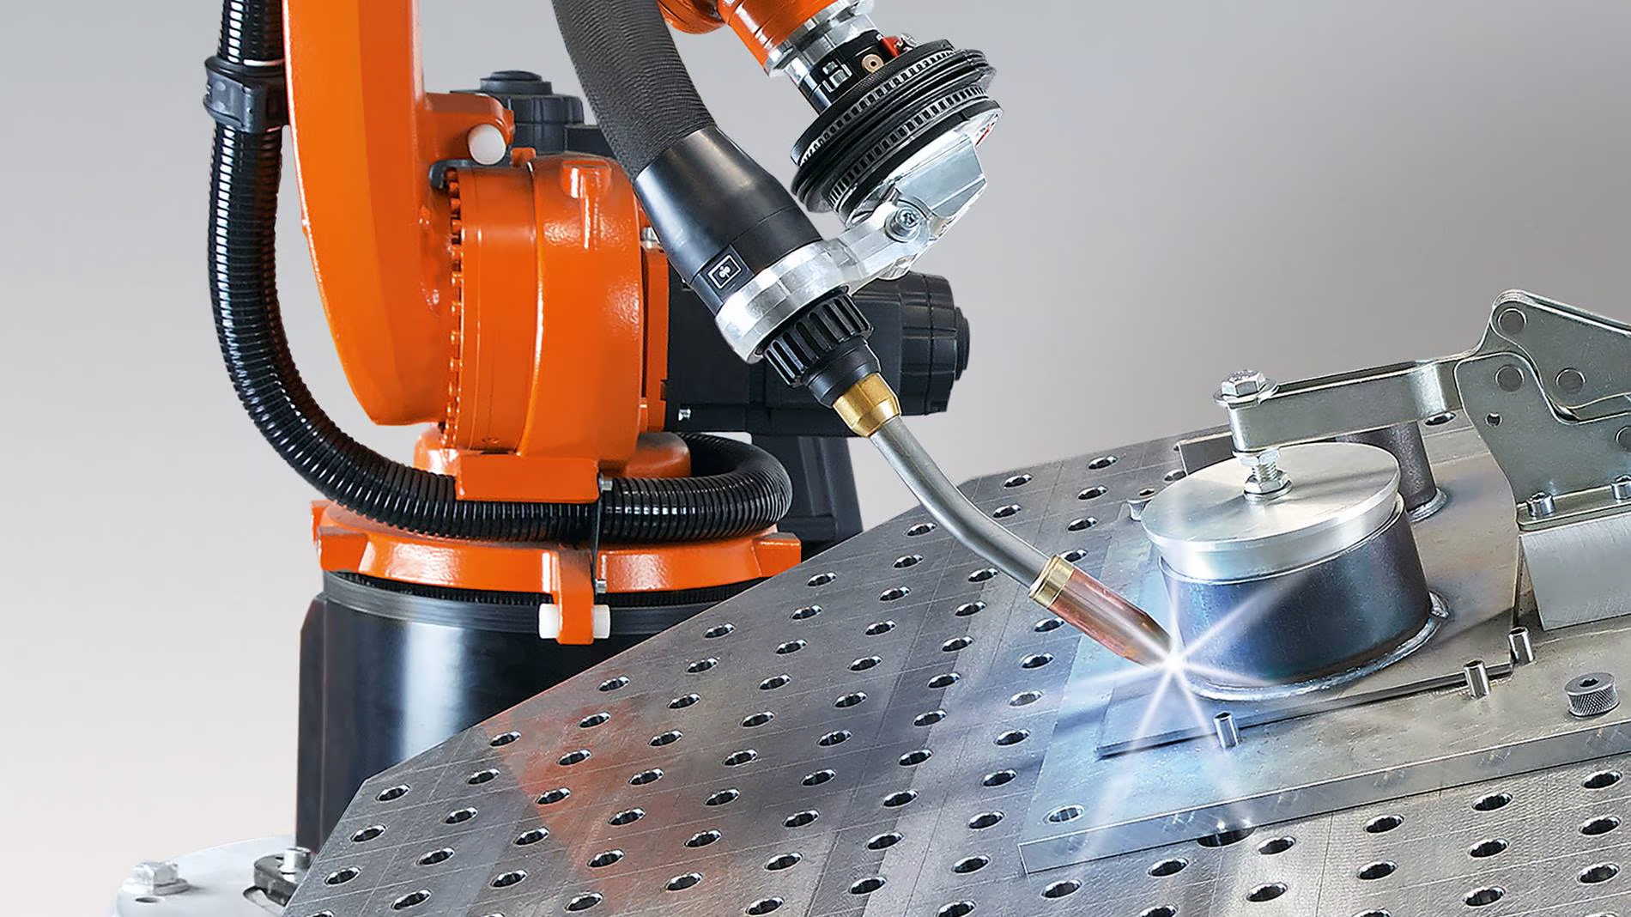
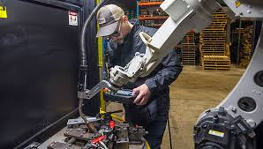
Introduction:
Advantages ?
Applications ?

Slide 6
Implementation:
Line
Inverse Kinematics
Determining
Welding Area
Choosing DOF
Choosing Links
Designing Robot
Rectangle
Square
Triangle
Simulation
Welded
Area

Slide 7
Implementation :
Steps to Design Welding Robot Manipulator
Step-1 : Choosing the Number of Links.
step-2 : Creating the Links with suitable DH parameters.
DH-Parameters:
Joint Angle (θ)
Joint Offset (d)
Link Length (a)
Twist Angle (α)

Slide 8
Implementation :
Steps to Design Welding Robot Manipulator
Step-3 : Connecting all the Links.
Step-4 : Using Inverse Kinematics, construct the path or location to weld.
Step-5 : Simulate the robot to weld through the area

Slide 9
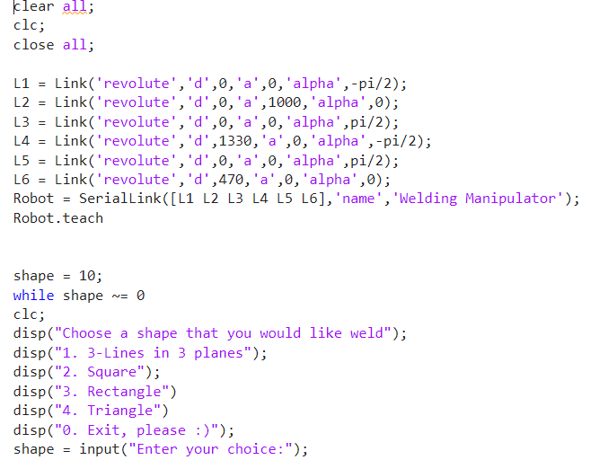
Code :

Slide 10
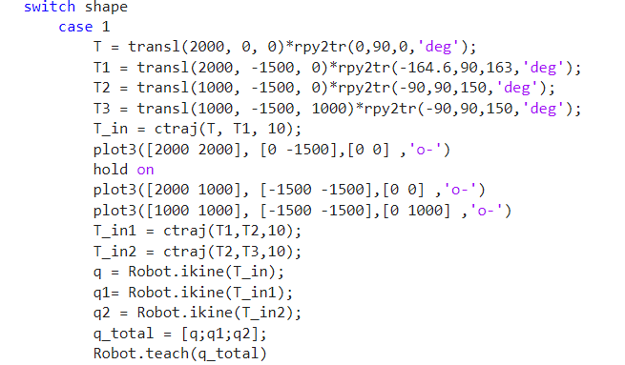
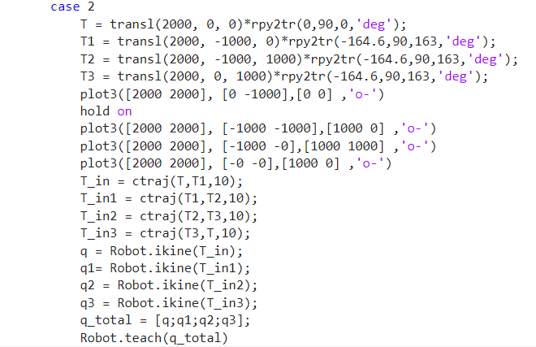
Code :

Slide 11
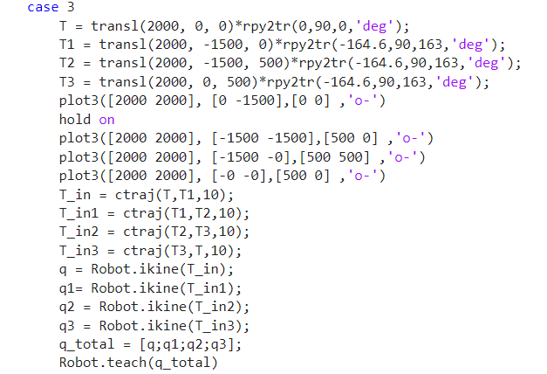
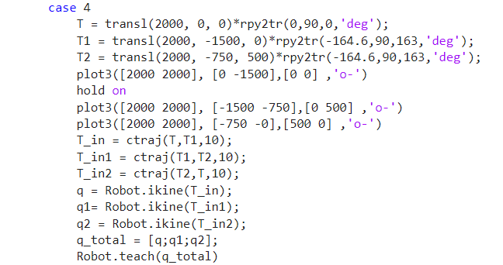
Code :

Slide 12
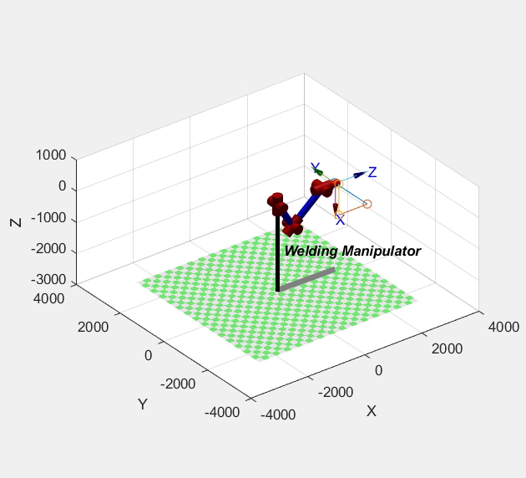
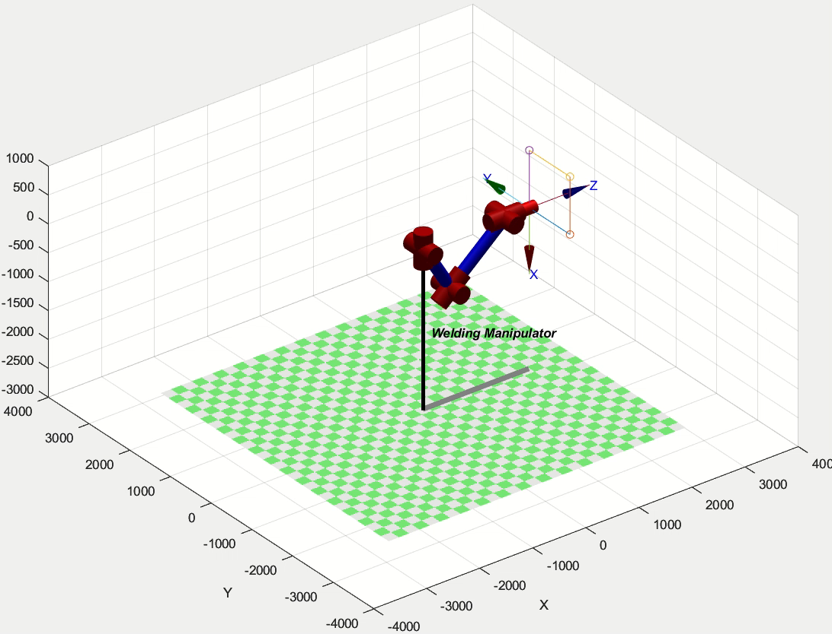
Output:

Slide 13
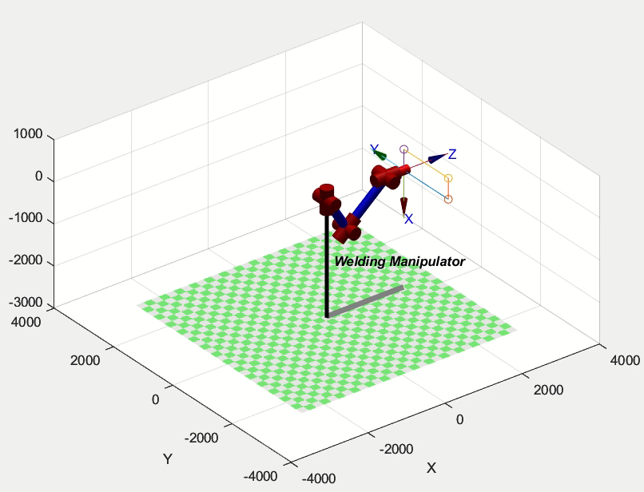
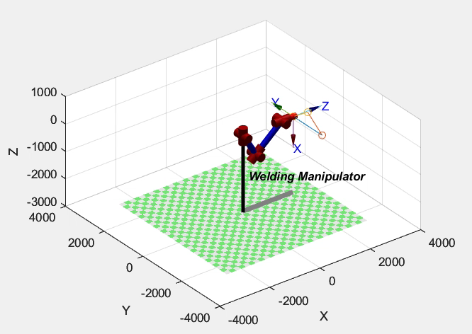
Output:

Slide 14
Conclusion:
Designed and implemented Welding Robot Manipulator with 6 DOF.

